Slide 1
Deserts and Desertification lecture 2 collected by : Maher M Alasadi

Slide 2
Definitions
Low Pressure Zone: Density of air < average. Warm, wet air that moves up reduces atmospheric pressure.
The heart of the low-latitude dry climates lies in the vicinities of the Tropics of Cancer and Capricorn.
As the warm, wet air rises, its ability to hold water is reduced and precipitation results.
Low pressure = precipitation likely.
High Pressure Zone: density of air is > average. Air is sinking, increasing atmospheric pressure. Cool, dry air so precipitation is unlikely – clear and sunny conditions.
Winds: pressure-driven currents of air moving from high pressure to low pressure. Can identify wind direction on an isotherm map.
Isobars: lines of equal/constant pressure.

Slide 3
Monsoons
Continents warm quickly in the summer and cool quickly in the winter.
Oceans are slower to heat up and cool down and this affects air currents so this system sees its winds change direction with the seasons
Dry regions cover 30% of the Earth’s surface
The dry regions of the world encompass about 42 million km2
, a surprising 30 percent of Earth’s land surface. No other climate group covers so large a land area

Slide 4
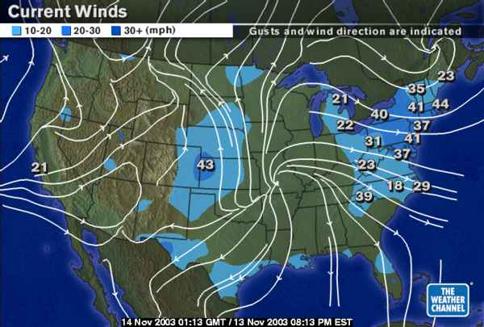
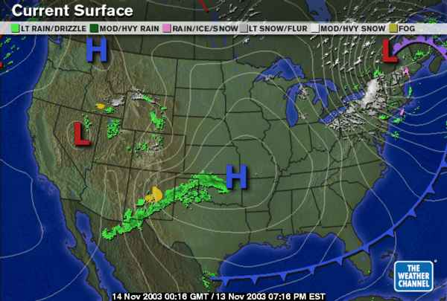
What causes deserts?
Important factors:
1-Global distribution of
air pressure
wind
Relationship between
rainfall
evaporation
www.weatherchannel.com

Slide 5
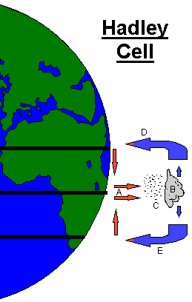
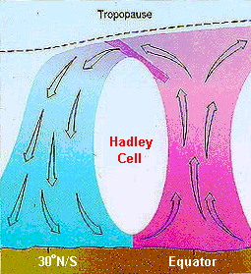
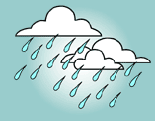
Why do deserts form ? (2)
DESERT
At the Equator (A) hot air rises and lifts lots of moisture into the air – where it makes clouds and rains.
JUNGLE
At (D) the air falls back to earth – but it’s now DRY air, and as it falls it WARMS UP – so no clouds form
EQUATOR
D
A

Slide 6
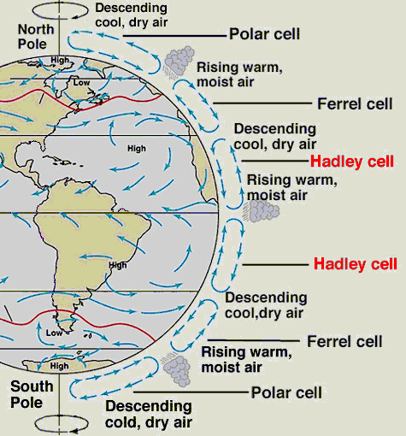
30*North, falling dry air means no clouds form – and you get DESERT
At the Equator ‘rising air’ causes lots of clouds and rain
30*South, falling dry air means no clouds form – and you get DESERT

Slide 7
For this reason, vast tropical rainforests grow near the equator.
Driven by wind
2- Solar energy produces differential heating
3- Coriolis effect(: Apparent force that moving objects experience due to the planet’s rotation, tending toward the right in the northern hemisphere and to the left in the southern hemisphere ).

Slide 8
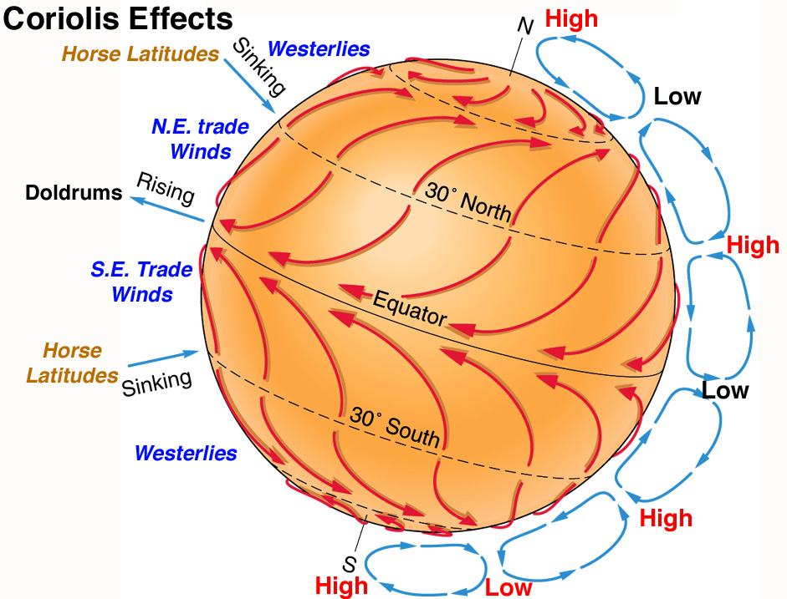
NOTE: high pressure around 30˚N and 30˚S, as well as at the poles, = DESERTS.

Slide 9
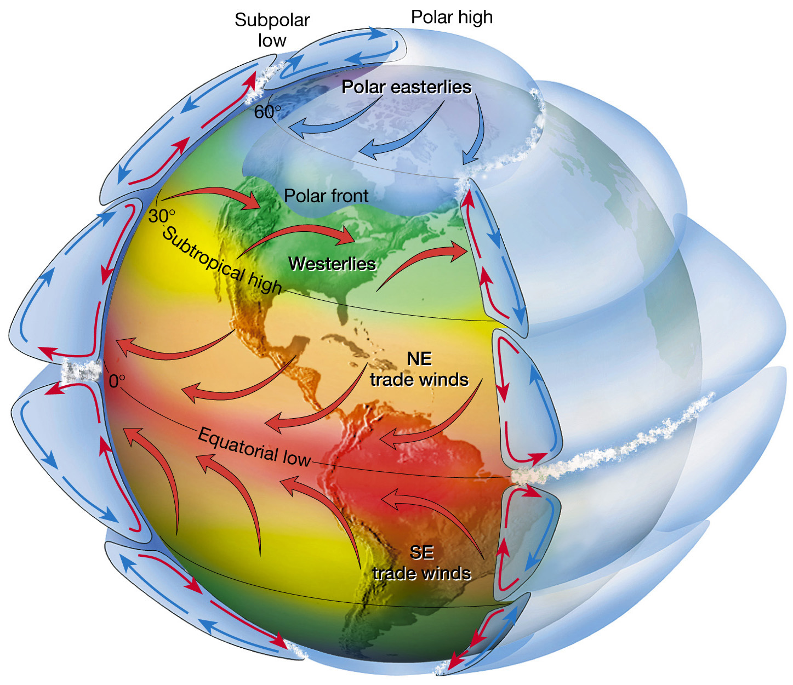
4-Effect of tilt and seasons and continents

Slide 10
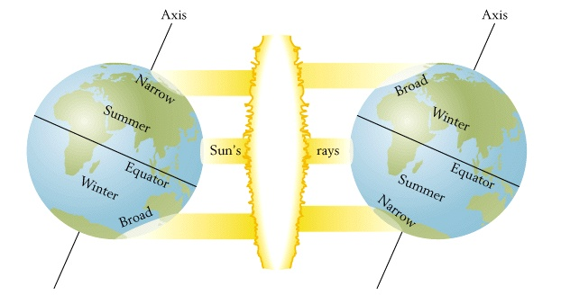
Tilt of the Earth and seasons

Slide 11
The part of the earth that receives most of the sun’s heat is the tropics—the region about the equator that lies between the tropics of Cancer and Capricorn. In the tropics the sun’s rays hit the earth almost at right angles, concentrating their heat energy on the smallest surface area. They also pass through the least depth of atmosphere, with minimal scattering and spreading, before they reach the surface. Farther north and south from the
equator the sun’s rays approach the earth at a slanting angle and their heat energy covers a correspondingly larger area
5-GLOBAL OCEAN CURRENTS
The planetary wind system plays an important role in the creation of the
oceans’ surface currents. In general, these currents follow the enormous
circulation loops around the oceans, delivering a huge supply of heat from
the equator to high latitudes. Most of the currents’ heat is lost along the
western boundaries of oceans, so that time they make their return journey
along the eastern boundaries they are cold.

Slide 12
6- Topographic Effects:
A- rain shadow: a phenomenon known as orographic lifting; oros is the Greek word for “mountain
Because atmospheric temperature falls with increasing height—by an average of some 6°C (11°F) for every 1,000 meters (3,280 ft.)—the air mass cools as it rises. And because cooler air can hold less moisture as water vapor compared to warm air, water vapor condenses into droplets that fall as rain on the windward side of the slopes,

Slide 13
The air now moves on, over the peaks of the mountains and down the leeward slopes—those lying away from the prevailing winds. By now it has lost most of its moisture content, so that little or no rain falls, creating a dry region on the leeward side of the mountains

Slide 14
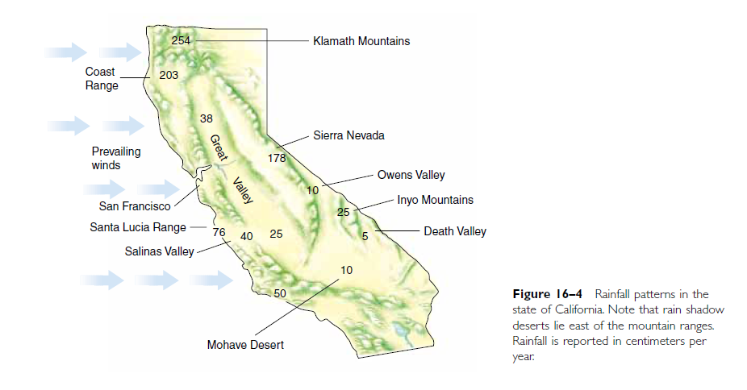

Slide 15
B- great distance from the ocean: since most rainfall comes from water evaporated from the sea, a great distance from the ocean is another factor that can create deserts, The air gradually loses its moisture and moves on

